Slide 1
Convex Hulls in Two Dimensions
Definitions
Basic algorithms
Gift Wrapping (algorithm of Jarvis)
Graham scan
Divide and conquer
Convex Hull for line intersections
  General solution
  Random lines

Slide 2
Convex Hulls
Convexity
Segment
Convex Hulls
Convex Combination

Slide 3
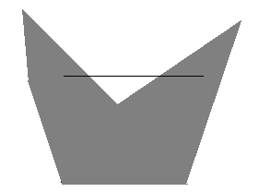
Convexity
A set S is convex if x ∈ S and y ∈ S implies
the segment xy ∈ S
x
y

Slide 4
Segment
The segment xy is the set of all points of the form
α x + β y with α ≥ 0, β ≥ 0 and α + β = 1
Thus for, End Point x : α = 1 and β = 0,
End Point y : α = 0 and β = 1,
Mid Point : α = 1/2 and β = 1/2
x(1,0)
y(4,0)

Slide 5

Convex Combination
A convex combination of points
  x₁ , … , x_{k} is a sum of the form α₁ x₁ + … + α_{k} x_{k}
  with α_{i} ≥ 0 for all i and α₁+ … + α_{k} = 1
  Example:
  Line segment
  Triangle
  Tetrahedron

Slide 6
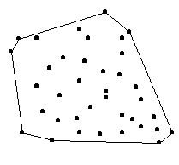
Convex Hull
Convex hull of a set of points S is the set of all convex combinations of points of S
Convex hull of S is denoted by conv S,
sometimes the notation
(S) is also used

Slide 7
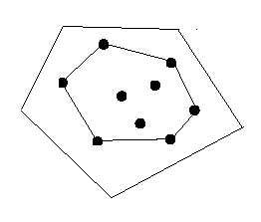
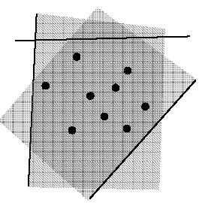
Some other definitions of Convex Hull
Convex Hull of a finite set of points S in the plane
is the smallest convex polygon P that encloses S
which means that there is no other polygon P’ such
that S ⊆ P’ ⊂ P
Intersection of all convex sets containing the points
in S

Slide 8
The convex hull of a set of points S in the plane is the union of all the triangles determined by points in S
Informal definition: Convex hull of a set of points in plane is the shape taken by a rubber band stretched around the nails pounded into the plane at each point
Now we define the convex hull problem:
- The problem is to construct the boundary of a convex hull in two dimensions given a finite set S of n points
- Four outputs can be distinguished for the above problem:
1. all the points on the hull, in arbitrary order;
2. the extreme points, in arbitrary order;
3. all the points on the hull, in boundary traversal order;
4. the extreme points, in boundary traversal order;

Slide 9
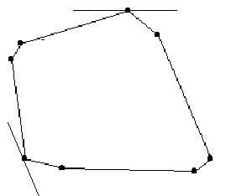
Extreme Points
The extreme points of a set S of points in the plane are the vertices of the convex hull at which the interior angle is less than π
Also a point is extreme iff there exists a line through that point that other wise does not touch the convex hull

Slide 10
Algorithms to find Extreme Points
A] Using Non Extreme Points
Identifying non extreme points implies identifying extreme points
A point is non extreme iff it is inside some (closed) triangle whose vertices are the points of the set and is
not itself a corner of that triangle.
Thus given a triangle:
  If a point is interior to triangle it is non extreme
  Corners of the triangle might be extreme
  Thus as the output we will get the extreme points in some arbitrary order.

Slide 11
Algorithm: Interior Points
for each i do
for each j ≠ i do
for each k ≠ i ≠ j do
for each l ≠ k ≠ i ≠ j do
if p_{l} ∈ Δ(p_{i} ,p_{j} , p_{k})
then p_{l} is nonextreme
There are four nested loops in this algorithm
Hence the order is O(n⁴)
For each of the n³ triangles, the test for extremeness costs n
It is important to find a faster algorithm

Slide 12
B] Extreme Edges
An edge is extreme if every point of S is on or to one side of the line determined by the edge
If we treat the edge as directed and let the left side of edge be inside then – the directed edge is not extreme if there is some point that is not left of it or on it
The output of this algorithm will be all the points on the convex hull in arbitrary order

Slide 13
Algorithm: Extreme Edges
for each i do
for each j ≠ i do
for each k ≠ i ≠ j do
if p_{k} is not left or on (p_{i} ,p_{j})
then (p_{i} ,p_{j}) is not extreme
There are three nested loops in this algorithm
Hence the order is O(n³)
For each of the n² pair of points, the test for extremeness costs n
The vertices that are extreme can now be found

Slide 14
C] Gift Wrapping (a more realistic hull algorithm)
A minor variation of Extreme Edge algorithm can accelerate it by
factor n as well as output the points in order
The idea is to use one extreme edge as an anchor for finding the next
Suppose the algorithm found an extreme edge whose unlinked
endpoint is x
For each y of set S we compute the angle θ
The point that yields the smallest θ must determine an extreme edge
The output of this algorithm is all the points on the hull in boundary traversal order
y
e
θ
x

Slide 15
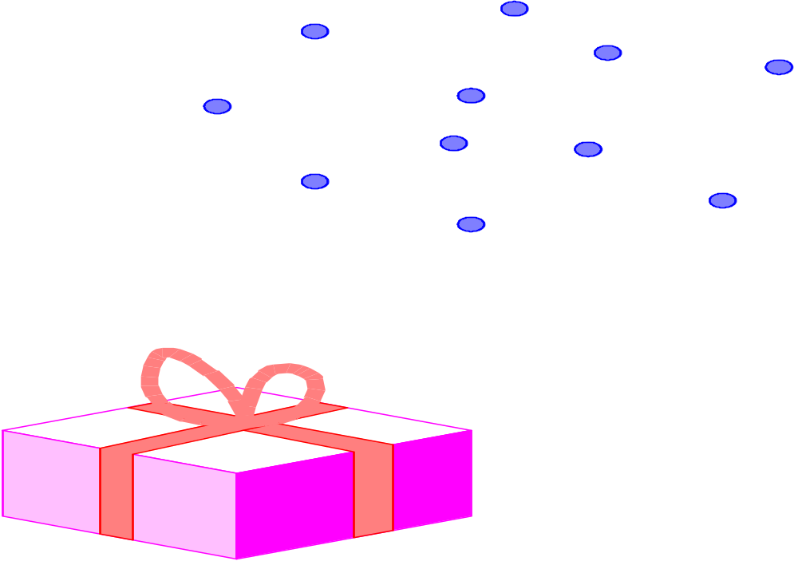
Idea: Think of wrapping a gift. Put the paper in contact with the gift and continue to wrap around from one surface to the next until you get all the way around.

Slide 16
Algorithm: Gift Wrapping
Find the lowest point (smallest y coordinate)
Let i₀ be its index, and set i ← i₀
repeat
for each j ≠ i do
compute counterclockwise angle θ from previous hull edge
Let k be the index of the point with the smallest θ
Output (p_{i} ,p_{k}) as a hull edge
i ← k
until i = i₀
We use the lowest point as the anchor
The order is O(n²)
The cost is O(n) for each hull edge
The point set is wrapped by a string that bends the that bends with
minimum angle from previous to next hull edge

Slide 17
Jarvis March - Example
p₁₀
p₉
p₆
p₁₂
p₇
p₅
p₄
p₃
p₁₁
p₈
p₁
p₂
p₀

Slide 18
Jarvis March - Example
p₁₀
p₉
p₆
p₁₂
p₇
p₅
p₄
p₃
p₁₁
p₈
p₁
p₂
p₀

Slide 19
Jarvis March - Example
p₁₀
p₉
p₆
p₁₂
p₇
p₅
p₄
p₃
p₁₁
p₈
p₁
p₂
p₀

Slide 20
Jarvis March - Example
p₁₀
p₉
p₆
p₁₂
p₇
p₅
p₄
p₃
p₁₁
p₈
p₁
p₂
p₀

Slide 21
Jarvis March - Example
p₁₀
p₉
p₆
p₁₂
p₇
p₅
p₄
p₃
p₁₁
p₈
p₁
p₂
p₀

Slide 22
Jarvis March - Example
p₁₀
p₉
p₆
p₁₂
p₇
p₅
p₄
p₃
p₁₁
p₈
p₁
p₂
p₀

Slide 23
Jarvis March - Example
p₁₀
p₉
p₆
p₁₂
p₇
p₅
p₄
p₃
p₁₁
p₈
p₁
p₂
p₀

Slide 24
Gift Wrapping
O(n |H(S)| )

Slide 25
Graham scan
O(n log n)

Slide 26
Step 1
Find a point, P, interior to the convex hull (CH) by taking the average of the coordinates of all the given points.
Another strategy might be to simply choose yMin.
P

Slide 27
Step 2
Translate the interior point, P, and all the others, so the interior point is at the origin.
Y
P
X

Slide 28
Step 3
Find the angle between the line connecting P to each of the points and the positive X-axis. Sort the points according to the magnitude of the angle.
The sorting determines the order that the algorithm will process the points.
Y
P
X

Slide 29
Step 4
If two points have the same angle, delete the point with the smaller amplitude (This step creates a new set of points S’).
Starting from the lowest Y-Axis coordinate CCW, label the points P0, P1, P2, ...
P4
P3
P2
P5
P1
P0

Slide 30
Step 5
Let labels Pa, Pb, Pc refer to P0, P1, P2 respectively.
P4
P3
Pc
P2
P5
Pb
P1
Pa
P0

Slide 31
Step 6
If the interior angle formed by Pa, Pb, Pc is greater than or equal to 180° then:
Eliminate the point labeled with Pb. Set point Pb to point Pa. Set point Pa to the previous point in the sequence (in this case P5).
P4
P3
P4
P3
Pc
Pc
Pa
P5
P5
θ
Pb
eliminate
Pa
Pb

Slide 32
Step 6 - Cont.
If the interior angle formed by Pa, Pb, Pc from before is less than 180° then:
No points are eliminated. Each of Pa, Pb and Pc are advanced forward one point.
P4
P4
P3
Pc
P3
Pc
Pb
P5
P5
θ
Pb
Pa
Pa
P0

Slide 33
Step 7
The Algorithm continues by repeating step 6 until Pb=P0. At this point, the algorithm stops and only the points of the convex hull remain.

Slide 34
Efficiency
Assume n is the number of points in S.
Step 1 can be done in O(n) operations.
Step 2 can be done in O(n) operations.
Step 3 can be done in O(n·Log(n)) operations.
Step 4 can be done in O(n) operations.
Step 5 can be done in O(1) operations.

Slide 35
Efficiency - Cont.
Note that each application of step 6 either eliminates a point (and partially moves backward) or moves forward (advancing Pc).
This means that after 2n iterations at the most, we’ll end up with the CH.
In conclusion, the algorithm will take O(n·Log(n)) operations.
This is the Lower Bound complexity. Otherwise we could sort better than O(n·Log(n)).

Slide 36
Graham Scan - Example
p₁₀
p₉
p₆
p₁₂
p₇
p₅
p₄
p₃
p₁₁
p₈
p₁
p₂
p₀

Slide 37
Graham Scan - Example
p₁₀
p₉
p₆
p₁₂
p₇
p₅
p₄
p₃
p₁₁
p₈
p₁
p₂
p₀

Slide 38
Graham Scan - Example
p₁₀
p₉
p₆
p₁₂
p₇
p₅
p₄
p₃
p₁₁
p₈
p₁
p₂
p₀

Slide 39
Graham Scan - Example
p₁₀
p₉
p₆
p₁₂
p₇
p₅
p₄
p₃
p₁₁
p₈
p₁
p₂
p₀

Slide 40
Graham Scan - Example
p₁₀
p₉
p₆
p₁₂
p₇
p₅
p₄
p₃
p₁₁
p₈
p₁
p₂
p₀

Slide 41
Graham Scan - Example
p₁₀
p₉
p₆
p₁₂
p₇
p₅
p₄
p₃
p₁₁
p₈
p₁
p₂
p₀

Slide 42
Graham Scan - Example
p₁₀
p₉
p₆
p₁₂
p₇
p₅
p₄
p₃
p₁₁
p₈
p₁
p₂
p₀

Slide 43
Graham Scan - Example
p₁₀
p₉
p₆
p₁₂
p₇
p₅
p₄
p₃
p₁₁
p₈
p₁
p₂
p₀

Slide 44
Graham Scan - Example
p₁₀
p₉
p₆
p₁₂
p₇
p₅
p₄
p₃
p₁₁
p₈
p₁
p₂
p₀

Slide 45
Graham Scan - Example
p₁₀
p₉
p₆
p₁₂
p₇
p₅
p₄
p₃
p₁₁
p₈
p₁
p₂
p₀

Slide 46
Graham Scan - Example
p₁₀
p₉
p₆
p₁₂
p₇
p₅
p₄
p₃
p₁₁
p₈
p₁
p₂
p₀

Slide 47
Graham Scan - Example
p₁₀
p₉
p₆
p₁₂
p₇
p₅
p₄
p₃
p₁₁
p₈
p₁
p₂
p₀

Slide 48
Graham Scan - Example
p₁₀
p₉
p₆
p₁₂
p₇
p₅
p₄
p₃
p₁₁
p₈
p₁
p₂
p₀

Slide 49
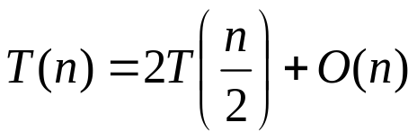
Convex Hull - Divide and Conquer
Algorithm:
  Find a point with a median x coordinate (time: O(n))
  Compute the convex hull of each half (recursive execution)
  Combine the two convex hulls by finding common tangents.
  Can be done in O(n)
Complexity: O(nlogn)

Slide 50
Convex Hull of Line Intersections. Motivation
  The database contains roads and the intersections of Tel-Aviv
  First intersections for an incoming guest are “important”.
  We need to find important intersections, i.e. the convex hull
  We don’t want to check all intersections.

Slide 51
Convex Hull of Line Intersections
  Applying one of the previous algorithms give O(n² log n) time
  Can we do better?

Slide 52
Algorithm of Atallah
Sort the n input lines by decreasing slope. L_{i} = a_{i}x+b_{i}
Let q_{i} be the intersection point between L_{i} and L_{i+1.} Q = {q₁,…,q_{n}}
Compute CH(Q). It is output of the algorithm

Slide 53
Algorithm of Atallah
The algorithm takes O(n log n) time

Slide 54
Correctness
L_{j}
p
L_{k}
w
v
L_{i}

Slide 55
Correctness
p – corner point => p in Q
Suppose that p = L_{i} ∩ L_{j} , i<j
If i + 1 = j or i = n-1 and j =0 than p in Q
Otherwise there exists k such that a_{i} < a_{k} < a_{j}
Since q ≠ p_{n-1} , one of the following is true
  j ≠ n-1
  i ≠ 0

Slide 56
Correctness (j ≠ n-1)
p
L_{j}
s
L_{k}
w
v
L_{i}
L_{n-1}

Slide 57
s
p
L_{j}
L_{k}
w
v
L_{i}
L_{n-1}

Slide 58
Random Lines
Each line is defined by the point with polar coordinates
The angles are distributed uniformly in [0, 2π]
The distances have common arbitrary distribution R with final E(R)

Slide 59
Random Lines
The angles are distributed uniformly in [0, 2π]
The distances have common arbitrary distribution R with final E(R)

Slide 60
Random Lines. Results
Devroye and Toussaint proved that for this case the expected number of points in the convex hull is O(1)

Slide 61
Random Lines
Algorithm
  Find the points in the convex hull using Atallah algorithm
  Gift wrapping

Slide 62
Random Lines
The sorting in the algorithm of Atallah requires expected linear time
Gift wrapping works in expected linear time

